Slide 1
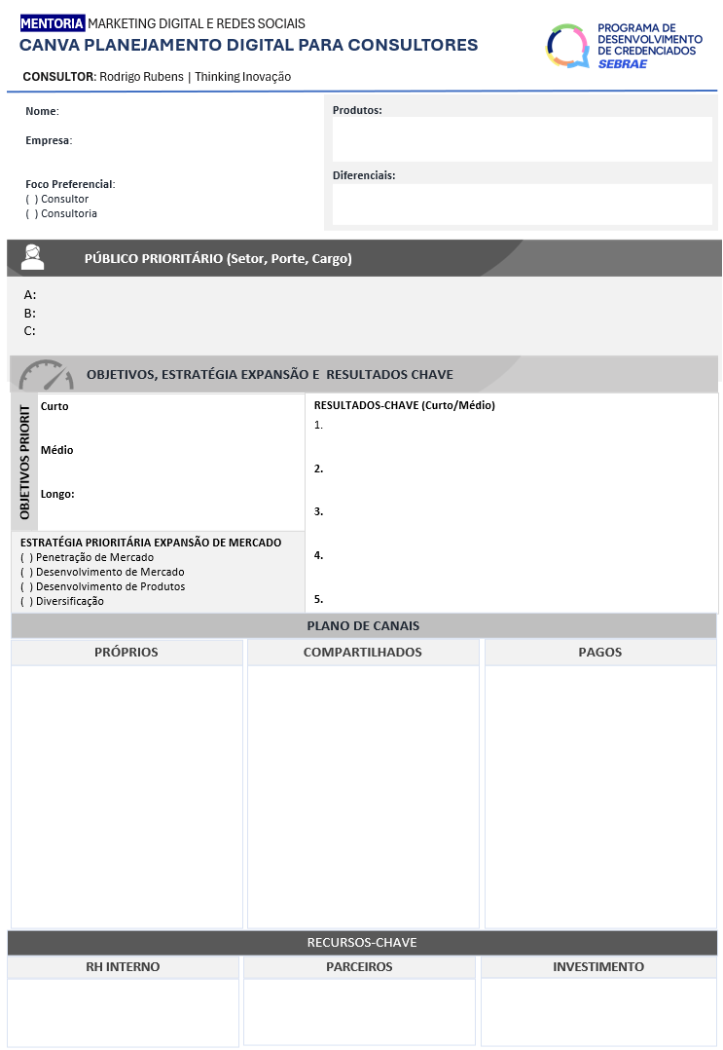
Preencha
Preencha
Preencha
Preencha
Preencha
Preencha
Preencha
Preencha
Preencha
Preencha
Preencha
Preencha
Preencha
Preencha
Preencha

